Slide 1
BIBLE TRIVIA GAME
By: Fiyin, Ewa, Zion

Slide 2
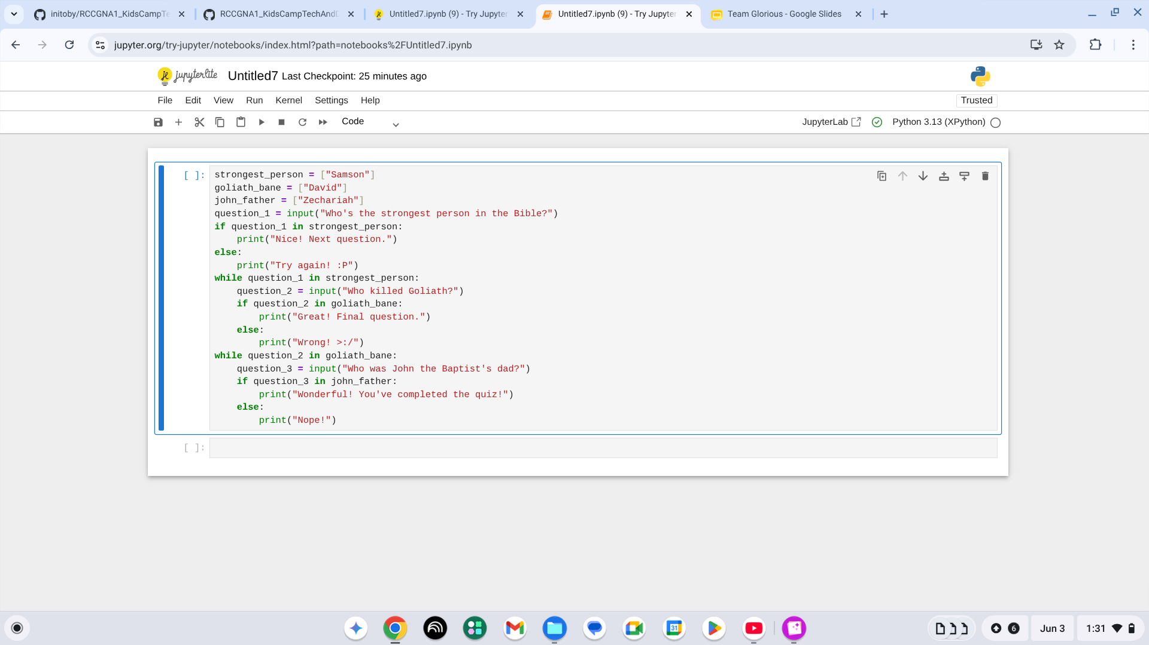
How we did it?
cxv
This code detects correct answers to display the next question

Slide 3
Question 1

Slide 4
Question 2

Slide 5
Question 3

